Slide 1

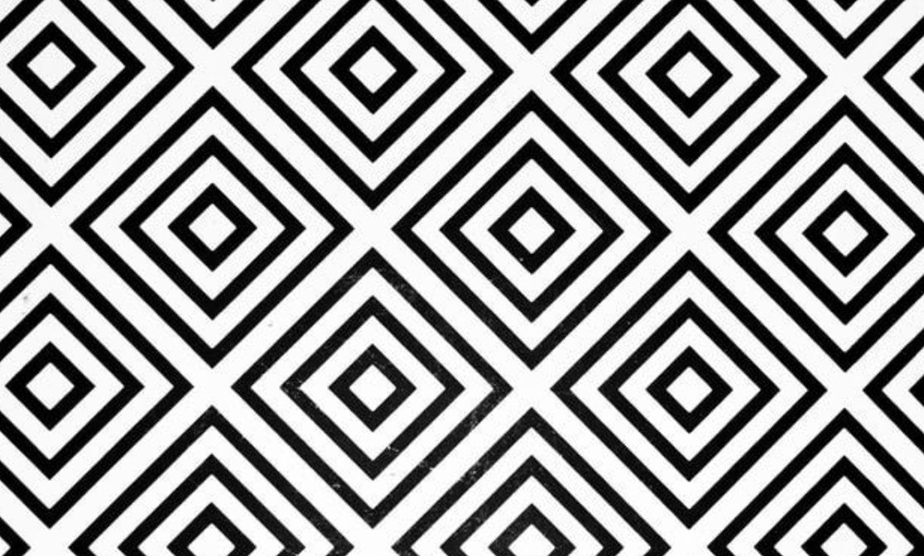
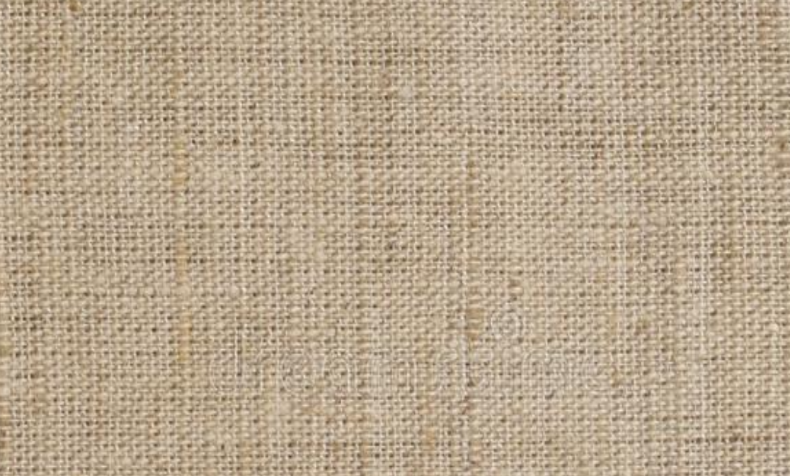
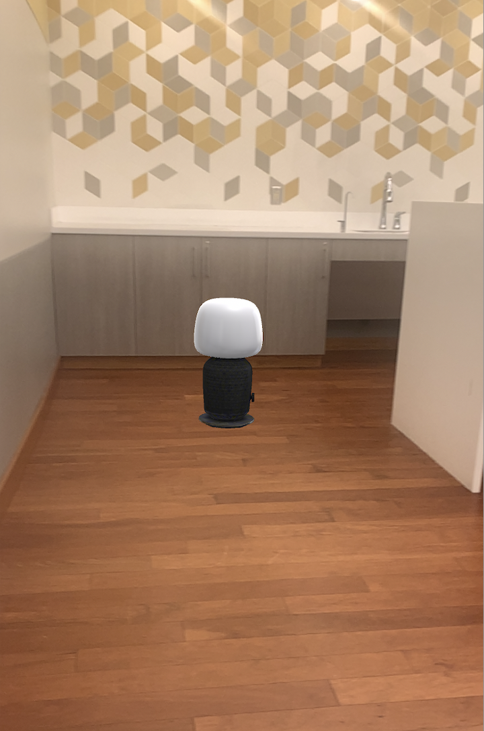
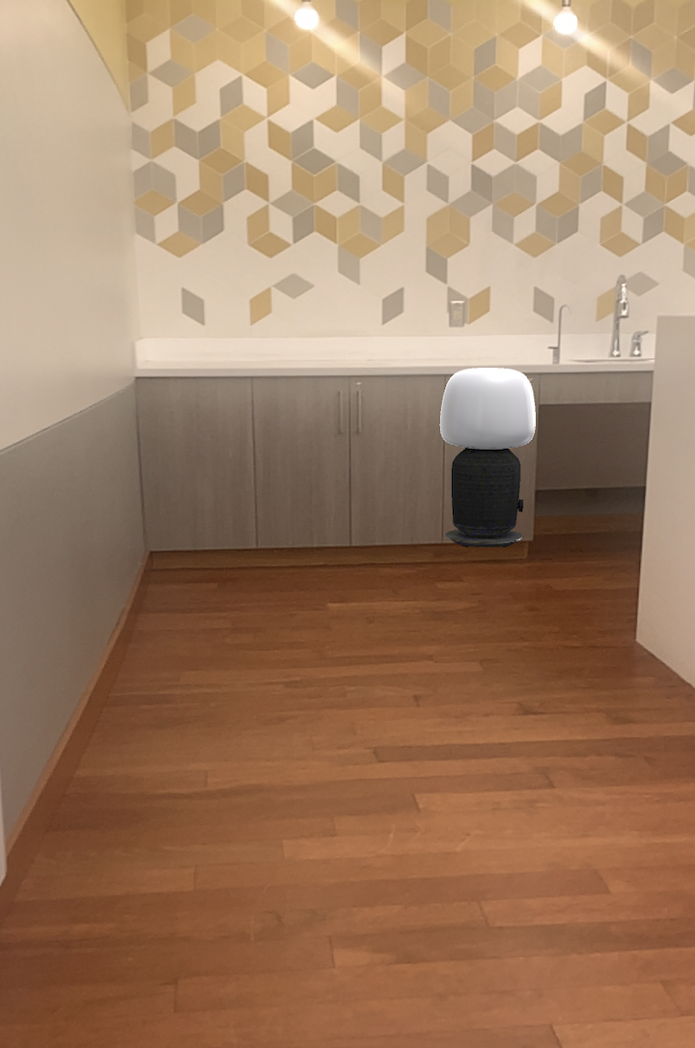
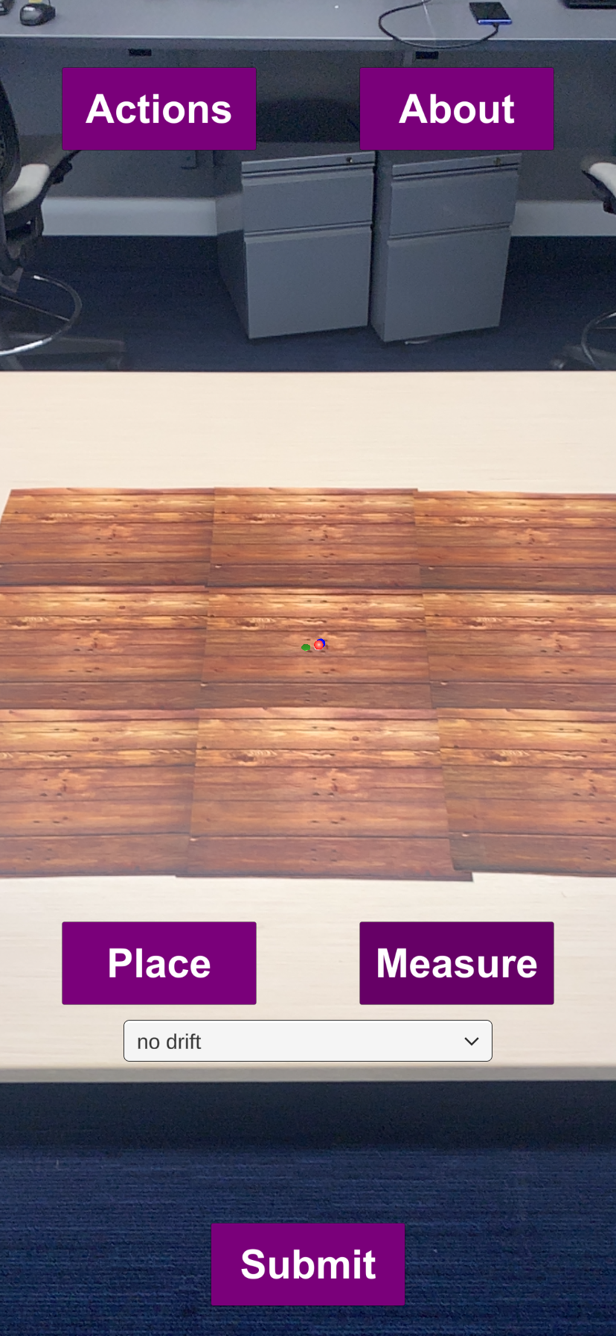
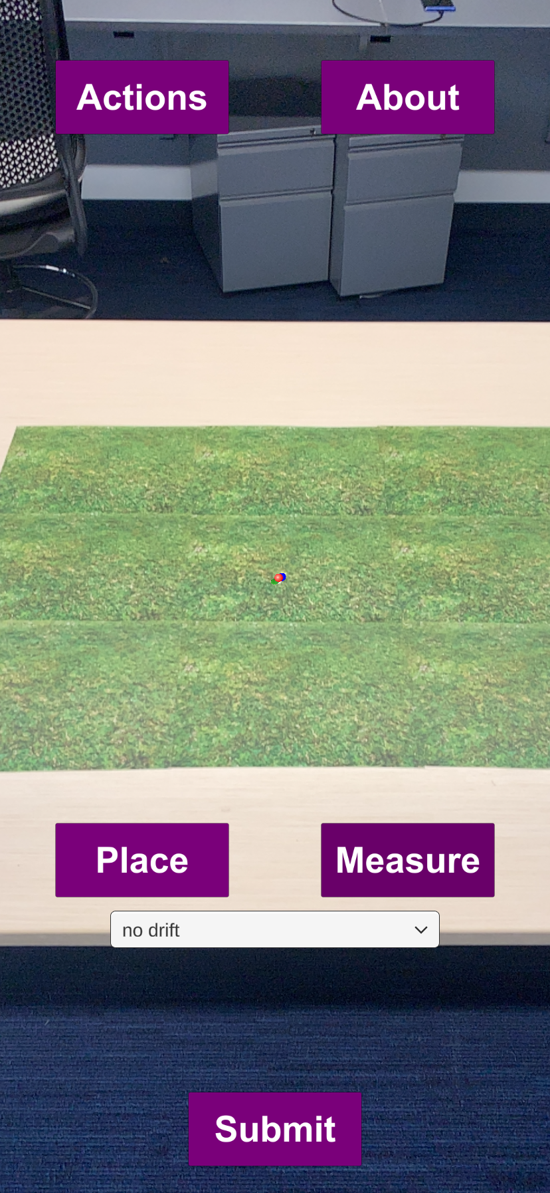
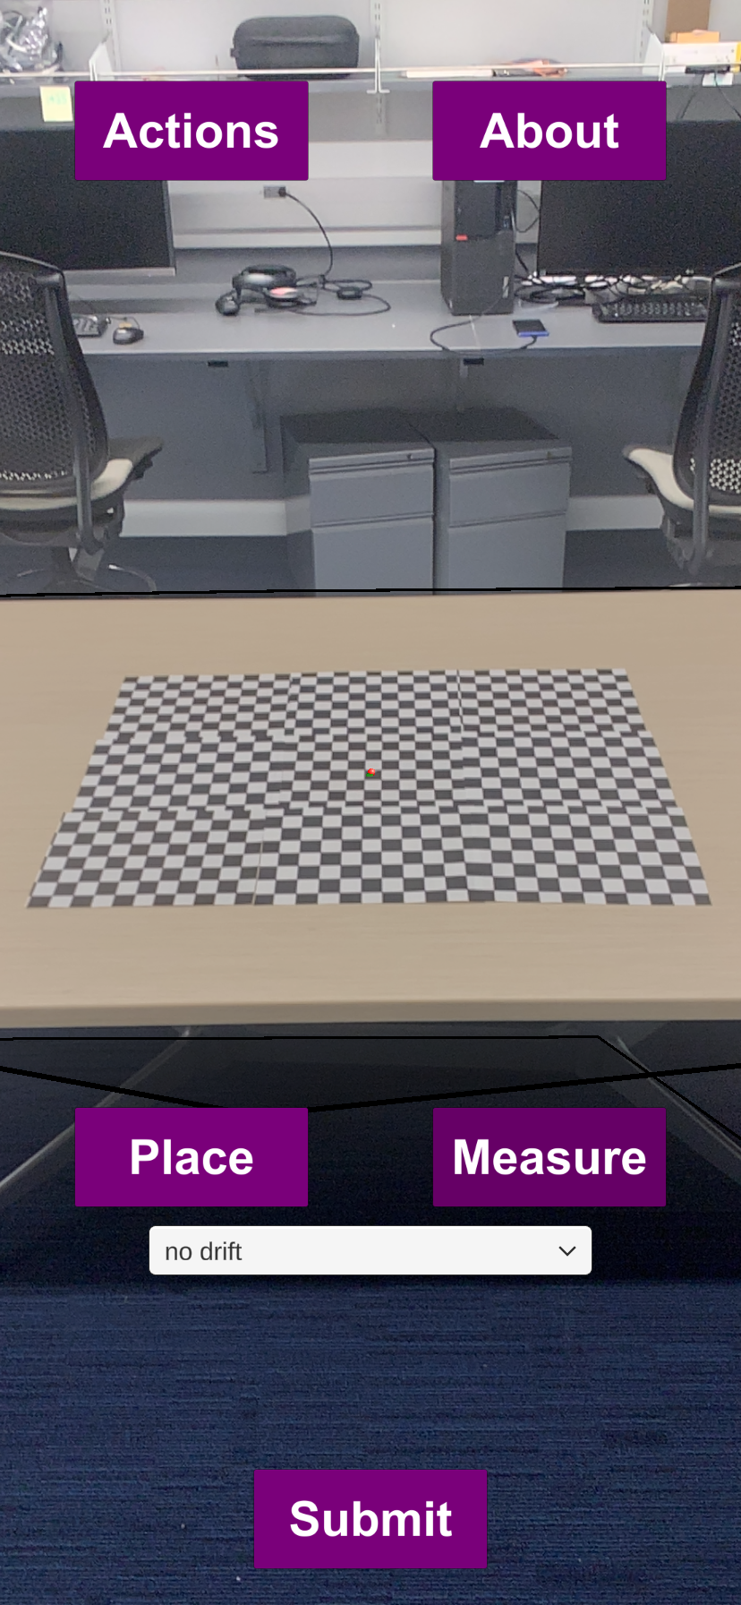



User Study in Precepted Augmented Reality Shift Jason Dong Intelligent Interactive Internet of Things (I^3T) Lab
Introduction
Experimental Apparatus
Results
Augmented reality (AR) is the enhancement of the physical world through the addition of digital visual elements, sound, or other sensory elements.
Unwanted hologram movement (drift) often occurs in markerless AR smartphone applications due to visual conditions or device movement.
Drift occurs due to the VI-SLAM algorithm incorrectly calculating the device pose (position and orientation) using on-board sensors.
Drift impacts user experience when using AR apps, but user perception of that drift may vary with different backgrounds. [1]
As a result, more severe drift may be less perceptible and tolerable with a plain backgrounds; whereas small drift may appear more extreme with textured backgrounds.
Several factors may impact perceived drift. Some possible influences may be more visible reference points in edges and corners, as well as other environmental factors such as distance and lighting.
I extended an iOS App built in Unity 3D to allow users to record their subjective experience of hologram drift. [2]
I wrote Python scripts to process the visual environment and drift data captured on the smartphone AR device.
3 surveys were created to record user consent, pre-experiment experiences, and post-experiment feedback.
Next, I designed and conducted an IRB-approved user study consisting of 10 participants to record their perception from hologram drift.
I wrote data analysis scripts to sort the experimental data and analytically graph the results along with the user input precepted drift.
I evaluated my visual environments using multiple camera image characterization metrics (brightness, complexity, edge strength, corners) to investigate correlations between then and drift or user perception of drift.
How do users perceive different magnitudes of drift?
How does viewing distance affect drift and perceived drift?
How does background texture affect affect drift and user input?
Figure 2: Example of background textures
Motivation
User Study Outline
Conclusions & Future Work
AR Applications such as IKEA Place, Amazon AR View, and others utilize placing holograms in the physical world to give customers a preliminary view of furniture in their room.
When using these AR apps, it is common for users to temporarily move their phone or look away.
As a result, hologram drift is common and the amount of the drift may be too extreme to be negligible for the user. [2]
This study aims at measuring hologram drift and determining a relation between perception of hologram drift in correlation with varying backgrounds.
Different viewing distances and different backgrounds affect both drift magnitude and perceived drift. [1]
They were asked to stand at the distance and place the virtual hologram object on top of a real world marker.
Next, participants were asked to walk away with the device at chest level to approx. 7 meters away and asked to return to their original spot.
The next task was to match up the hologram marker with the real world marker again.
Lastly, the user was asked to record their perceived drift between the two placed holograms: no drift, small drift, medium drift, large drift, can’t see hologram (modeled on a previous user study [3]).
User perceived drift noticeably increases with greater increase in physical drift.
Overall, “no drift” and “small drift” share more overlap among participants, whereas “medium drift” and “large drift” are distinct.
As viewing distances increase, more drift results from errors in the Vi- SLAM algorithm, with users also noticing this difference.
Simple backgrounds with less patterns may be more tolerable for users when there is noticeable drift.
The user study does not definitely show background textures having a significant impact on perception of drift, but more complex patterns appear to result in a larger range of perceived drift.
Explore thresholds on when drift negatively affects user experience.
Explore metrics that best predict drift and perceived drift.
Participants were asked to perform trials on 3 distances (50cm, 100cm, 150cm) and 6 different textures of varying complexity for 18 total tests.
Related Publications / Citations
[1] Gibson, J. J. (2002). A theory of direct visual perception. Vision and ……mind: Selected readings in the philosophy of perception, 77-90.
[2] Scargill, T.J., Chen, J., & Gorlatova, M. (2021). Here to stay: Measuring ……hologram stability in markerless smartphone augmented reality. arXiv, ……abs/2109.14757.
[3] Toms, E. G., & Taves, A. R. (2004). Measuring user perceptions of web …...site reputation. Information Processing & Management, 40(2), 291-317.
Figure 1: Example of
drift in IKEA Place
Figure 3: Example of
user study trials
Notes:
Multi-user collaboration pics insert
CHANGE AR EXAMPLES
PHOTO OF A MAGIC LEAP INSERT SOMEWHERE

